Slide 1

Capstone Project
Prepared by :-
Group name:- RAW
22_Mehul Makwana
29_Utsav Nathani
19_Sunny Kawa
06_Kartik Chudasama
30_Darshan Panchal

Slide 2
Introduction
Project name : ‘’The Phonebook Application’’
This project is written in React js and Node js. The concept of an array, strings, structures, file management and functions are often used in almost all functions in this project.
‘’The Phonebook Application’’ is a very simple tool that helps the user to perform the functions like : Adding a new contact, View list of existing contacts, modifying a contact and searching a contact.
Adding new items, viewing , editing and updating, searching for saved contacts and deleting data in the phonebook are the main features of The phonebook application.

Slide 3
Proposed Project
Under this Phonebook Project, all the functionality has been added to meet the user's requirements in just few seconds. To provide the desired result on time, it is using with MongoDB server, Active-X in any Windows system and used binary search method has been used to produce results on minimal time. As customers do not have to purchase new volumes, each year and even they do not have to wait for the New Year to get updated records. As the new customer does the user side, so users will able to get updated information catch time will update details. To eliminate data redundancy and perform validation process background codes by the class will responsible to do this task.
If user will make any mistake while entering, they will be given a warning along with correction, which is required to be made. It will also guide the customers to use this system in convenient manner through its graphical screen. It not only contains local codes but also ISD codes. The names are present in user-sated formats like alphabetical order, according to time, date, recently etc. so that user also can easily find the required person along with their address and telephone numbers and use search option.

Slide 4
Reason for Selecting
Phone Book System is a small web application developed for mini project students. In olden days we stored all our important contact details in books and papers. Here we proposed a new system, by using this application we can store all the details in a central repository.
In manual method if we forget information book then it is very difficult to get the contact details. By using this application, we can see our contacts anywhere in the world, here we will have security to the login page and no one can see our contacts without proper authentication. In this project we can save our contacts and we can search them by name and we can see all of them at a time.

Slide 5
What is front end ?
This is a part of a website that the user interacts with directly is termed the front end. It is also referred to as the ‘client side of the application. It includes everything that users experience directly: text colors and styles, images, graphs and tables, buttons, colors, and a navigation menu.
HTML, CSS, and JavaScript are the languages used for Front End development. Responsiveness and performance are the two main objectives of the Front End. The developer must ensure that the site is responsive i.e. it appears correctly on devices of all sizes no part of the website should behave abnormally irrespective of the size of the screen.

Slide 6
What is back end ?
Back-end development means working on server-side software, which focuses on everything you can’t see on a website. Back-end developers ensure the website performs correctly, focusing on databases, back-end logic, application programming interface (APIs), architecture, and servers. They use code that helps browsers communicate with databases, store, understand, and delete data.
Programming languages: Python. PHP. JavaScript. Java.
Frameworks: Node. js.
Databases: MongoDB. MySQL.

Slide 7
Methodology
Under this Phonebook Project, all the functionality has been added to meet the user's requirements in just few seconds. To provide the desired result on time, it is using with SQL server, Active-X in any Windows system and used binary search method has been used to produce results on minimal time.
As customers do not have to purchase new volumes, each year and even they do not have to wait for the New Year to get updated records. As the new customer does the user side, so users will able to get updated information each time will update details.To eliminate data redundancy and perform validation process background codes by the class will responsible to do this task.

Slide 8
Project Technical Specification
Visual Editor
Programing Language
Database Support
Project Type Contact data management

Slide 9
Limitation and Future Application of the Project
Limitation of the System:-
System works in all platforms and its compatible environments.
Advanced techniques are not used to check the authorization.
Future Enhancements:-
As the technology emerges, it is possible to upgrade the system and can be online.
Based on the future security issues, security can be improved using emerging technologies.
GPS can be added
Online with OFFLINE mode.

Slide 10
Resources /References
1. Telephone Directory
2. YouTube
3. Online resources

Slide 11
Data base diagram
Database
Users
New create
, Edit , Search , Display

Slide 12
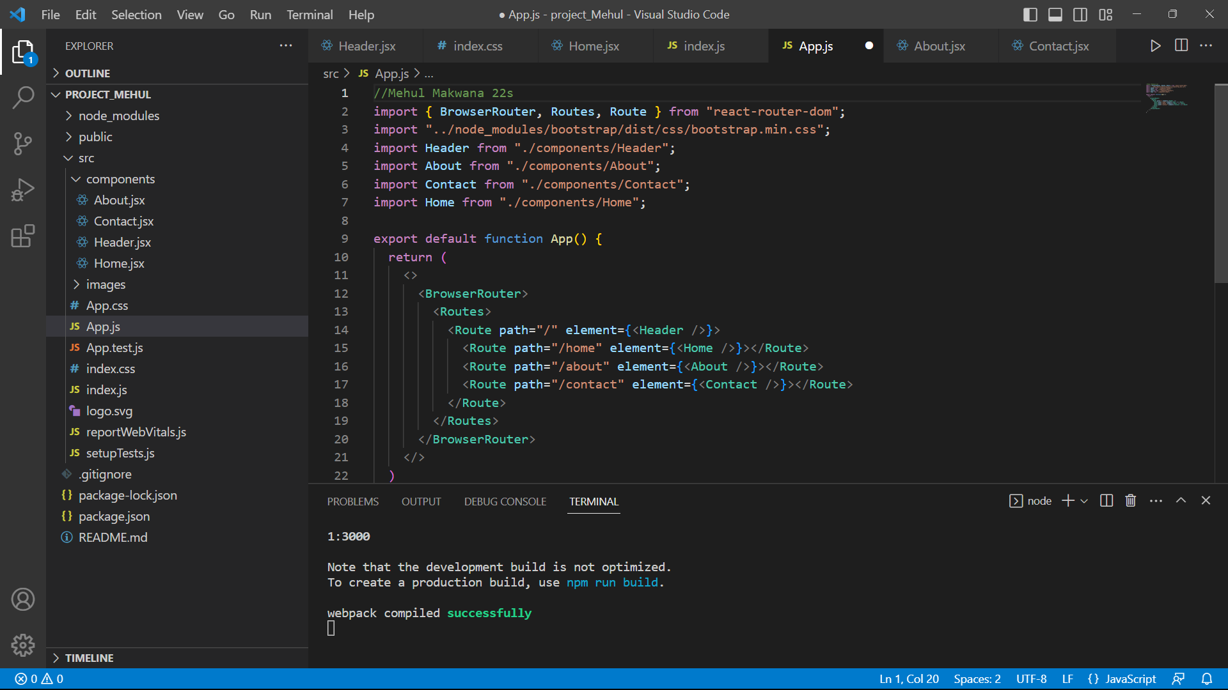
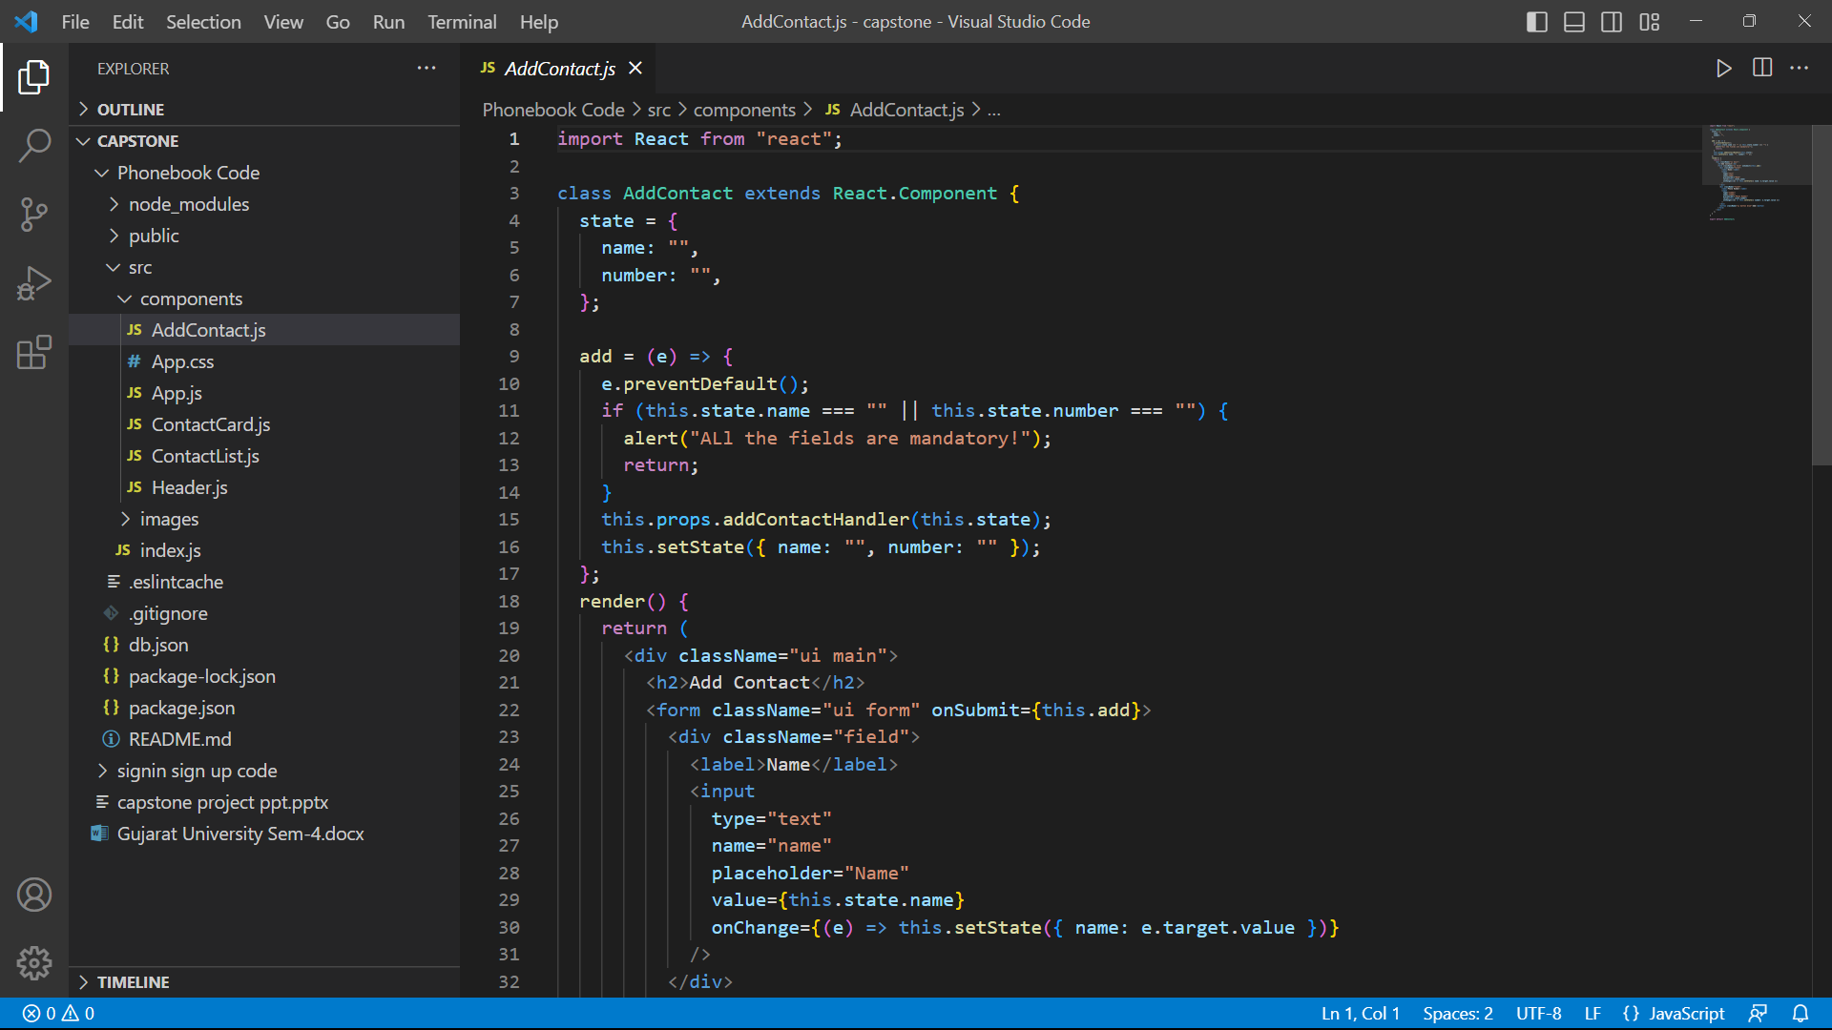
How to Add a New Contact in Phonebook ?
Enter 1 in the main window of phonebook application.
You can see the window named as “Add New Contact”.
Enter your details such as name, mobile number, father name, mother name, gender, E-mail and address.
After giving such information the completion message appears as “Contact Saved Successfully”.
Now, you can add another contact by pressing ‘y’ or you can continue to the main window by pressing any key.
E.g., Here contact of a person named Abhishek is added to the phonebook.

Slide 13
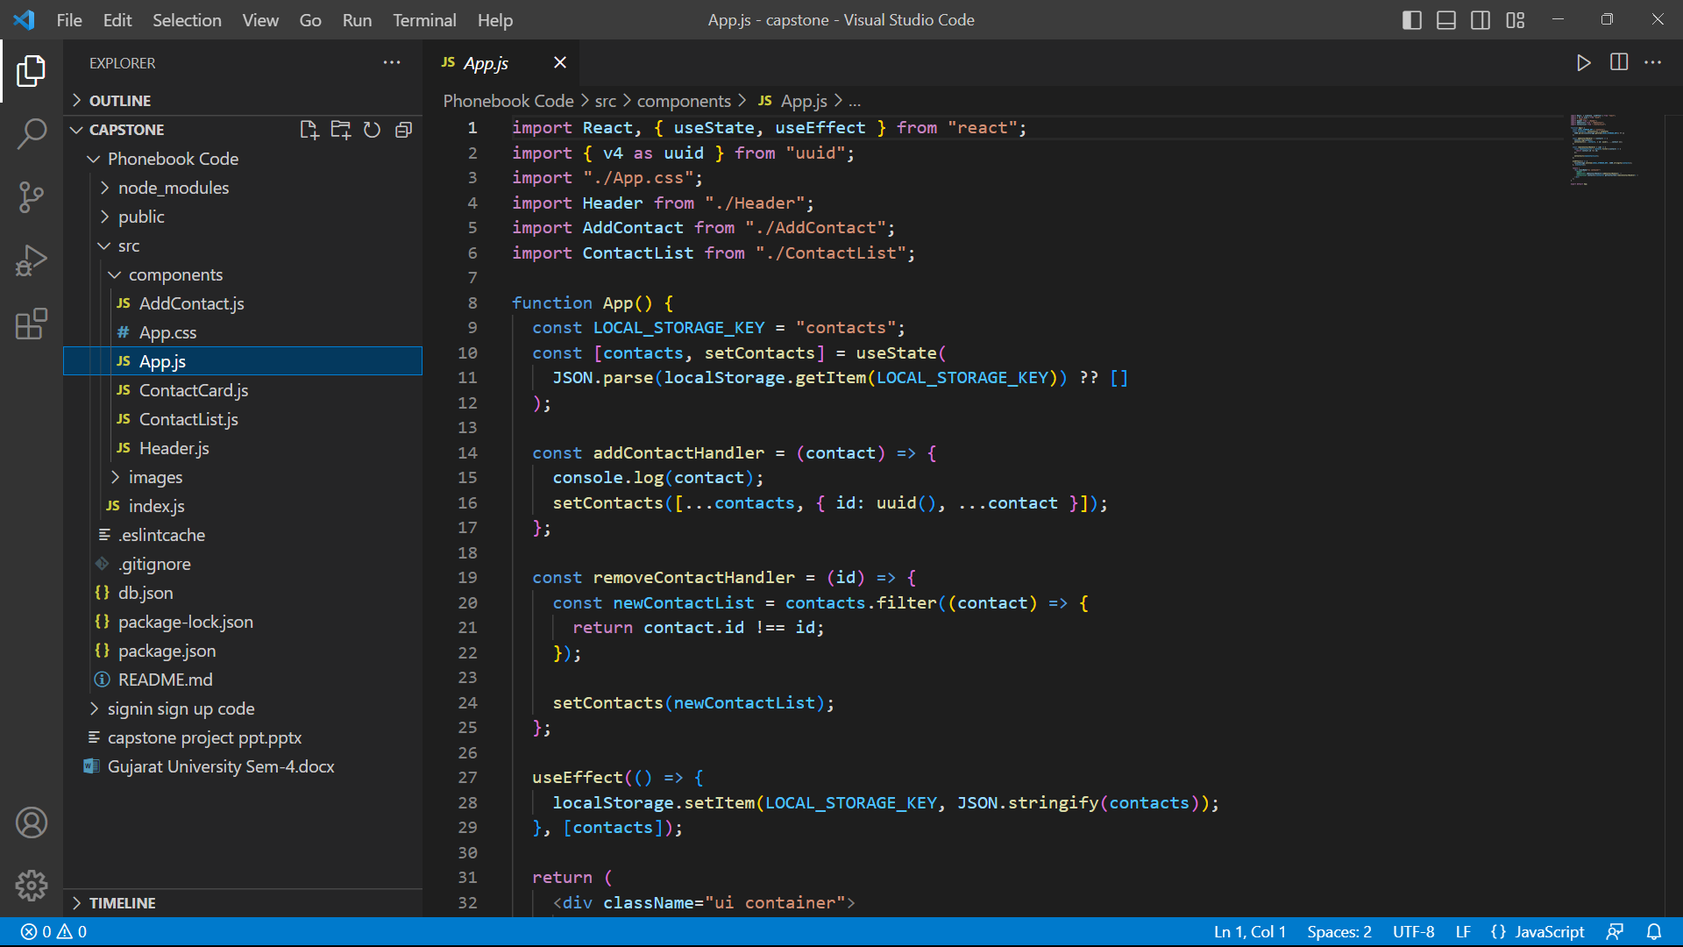
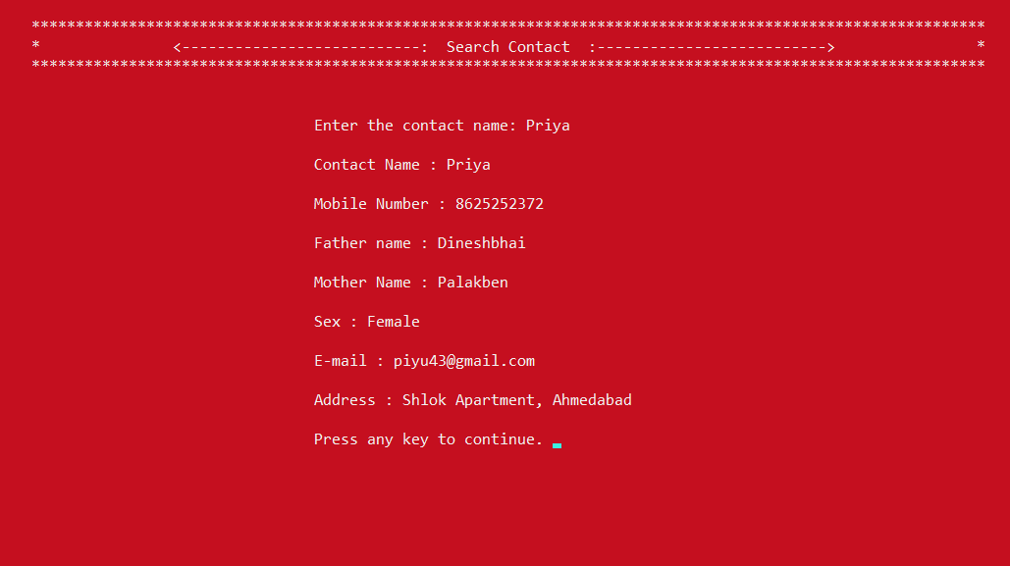
How to Search existing Contact in Phonebook ?
Enter 4 in the main window of phonebook application.
You can see the window named as “Search Contact”.
The message will be appear as “Enter the contact name”.
Enter the name of person that you want to search. Then, You will get information such as name, mobile number, father name, mother name, gender, E-mail and address of that person.
Now, you can continue to the main window by pressing any key.
E.g., Here person named Priya is searched.

Slide 14
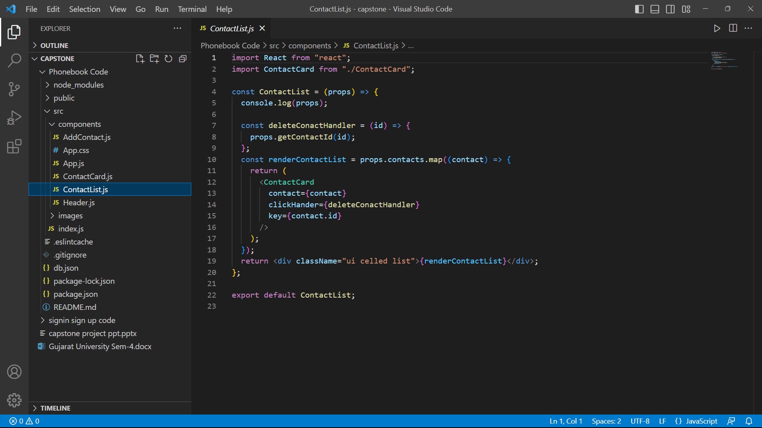
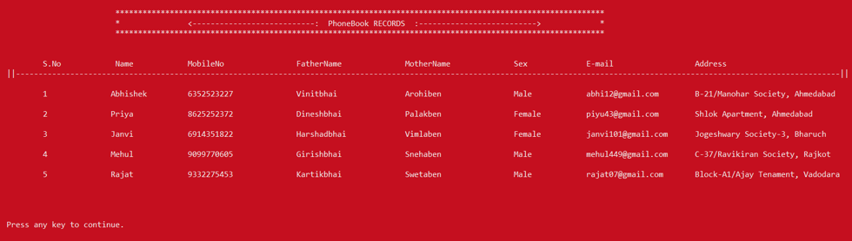
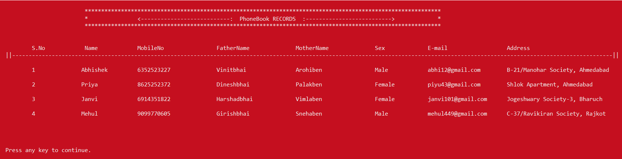
New List After Contact Deletion

Slide 15
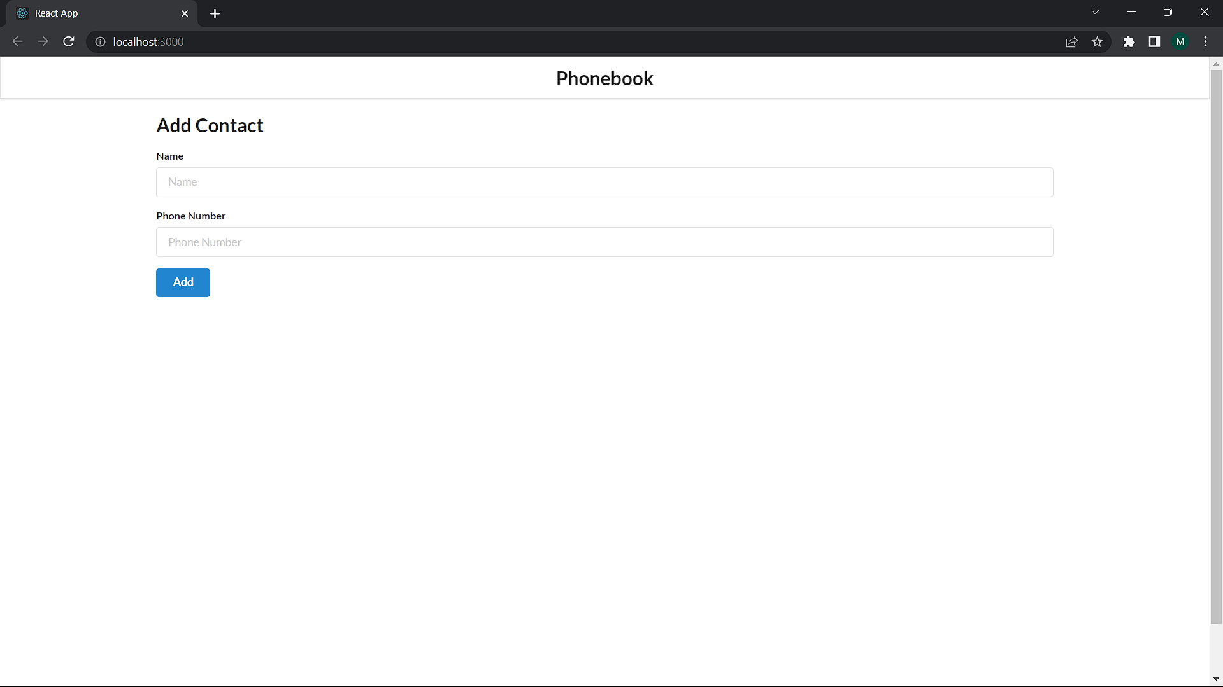
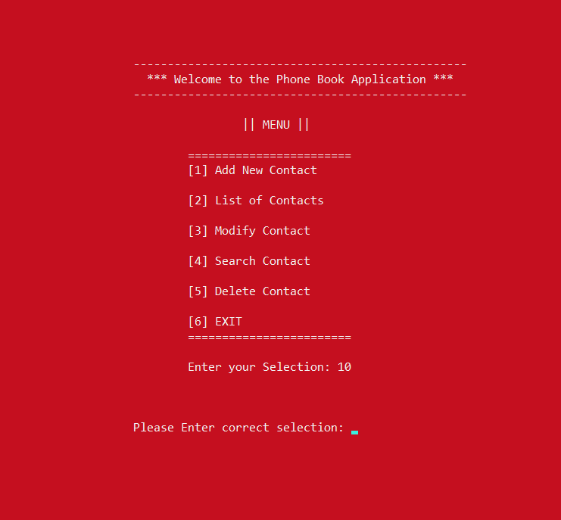
How to Exit From Phonebook Application?
By entering 6 in the main window, you can exit from phonebook application.
In case of wrong selection, the message appear as “Please Enter Correct Selection”.
Then, you will be able to enter another selection for further process.

Slide 16
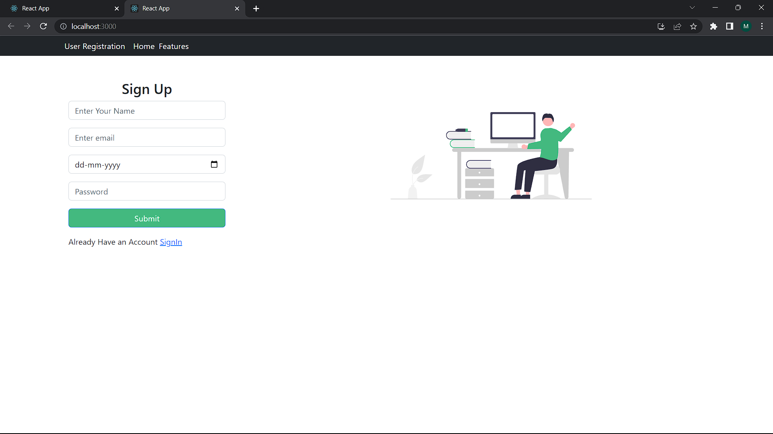
Sign up page

Slide 17
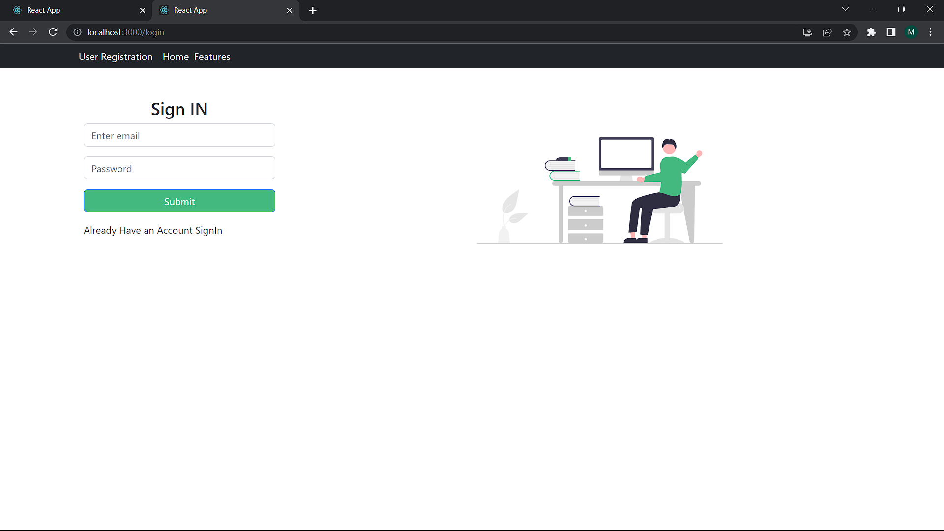
Sign in page

Slide 18
Conclusion
This application software has been computed successfully and was also tested successfully by taking "test cases". It is user friendly, and has required options, which can be utilized by the user to perform the desired operations.
The software is developed using as front end and MongoDB as back end in Windows environment. The goals that are achieved by the software are:-
Optimum utilization of resources.
Efficient management of records.
Simplification of the operations.
Less processing time and getting required information.
User friendly.
Portable and flexible for further enhancement.

Slide 19

Thank You !

